Slide 1
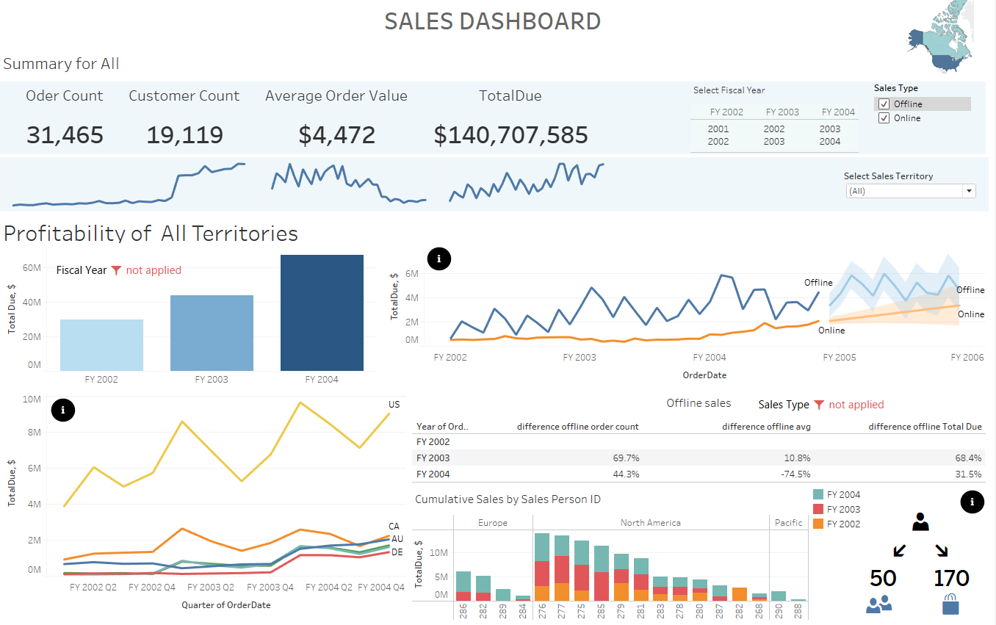
AdwentureWorks SALES
Notes:
Hello, today I want to present AdwentureWorks sales situation. This presentation is prepared for the sales department.

Slide 2
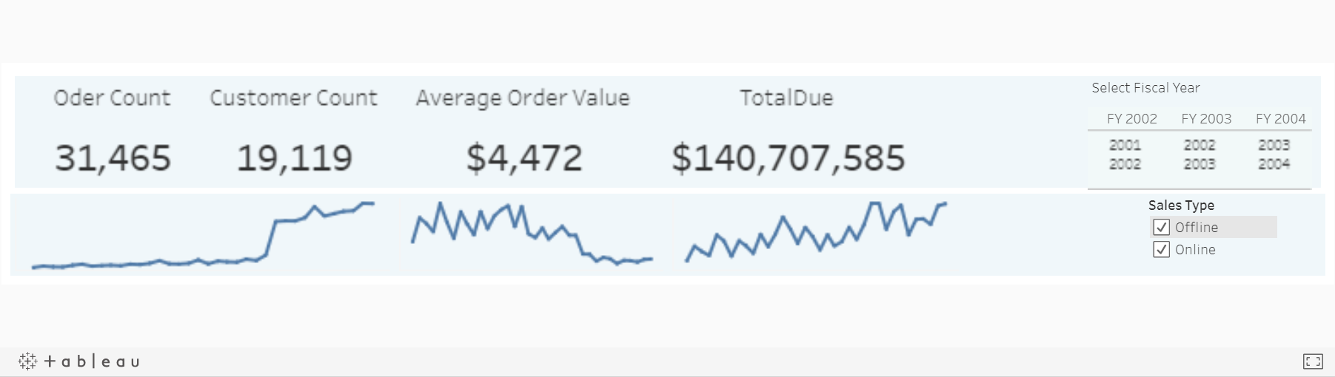
Average Order Amount
Notes:
2004 fiscal year was the best fiscal year for the company.
47,85% of the sales ware generated during 2004 fiscal year. 2004 fiscal year grew in 54% in comparison with the previous fiscal year.
The average amount per order is 4472 in general. When the average of non online order is 28446 and online - 1173. That is 24 times less.

Slide 3
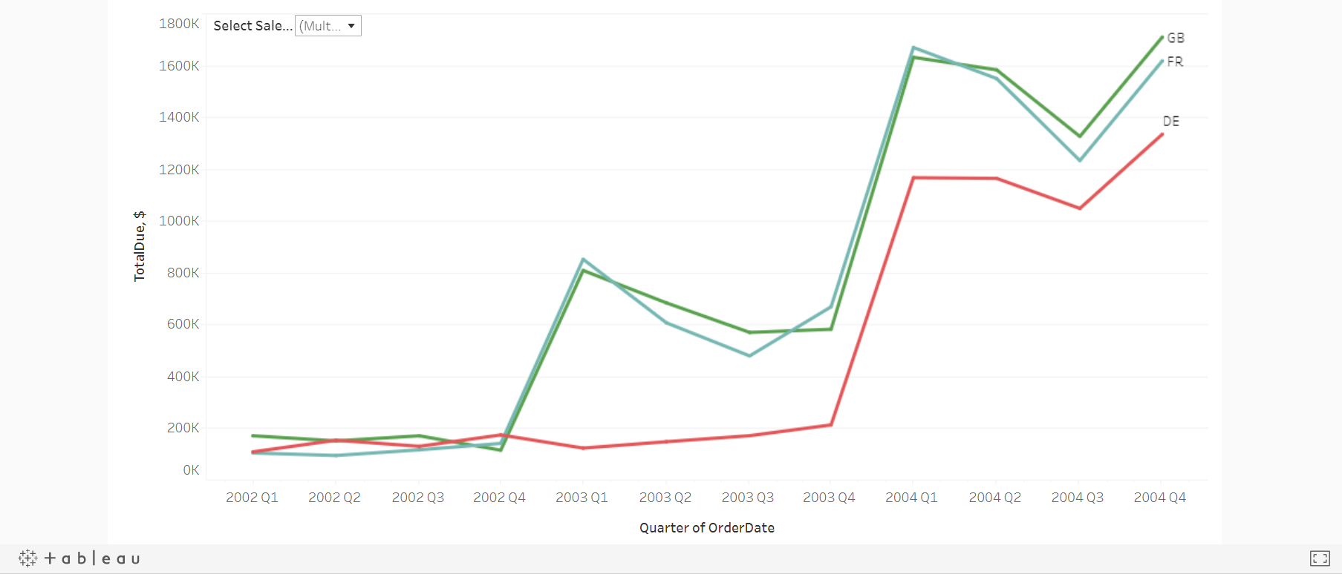
Europe Sales Growth
Notes:
Sales in North America are leading. But Europe countries grew in sales as well. They began generate bigger sales only when the offline sales start in those countries.
In United Kingdom, France, Germany sales grew approximately twice as offline sales started.

Slide 4
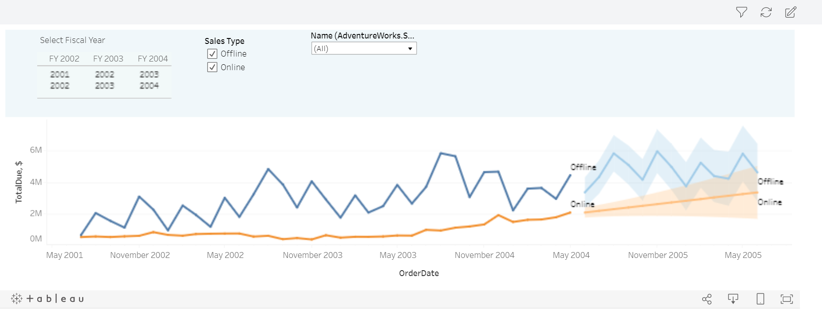
Growth of the Sales
Notes:
Generally, online orders are more frequent but lower in volume
Offline sales are, on average, 30% higher than online sales.
During the last fiscsal year the sales grew in 30 percent but the average amount got in 74 present lower.

Slide 5
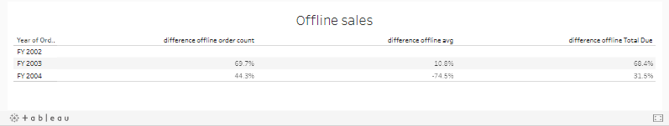
Offline Sales
Notes:
As offline sales are so big in volume, they are valuable for the company. Due to this I want to present them to you in more detail.

Slide 6
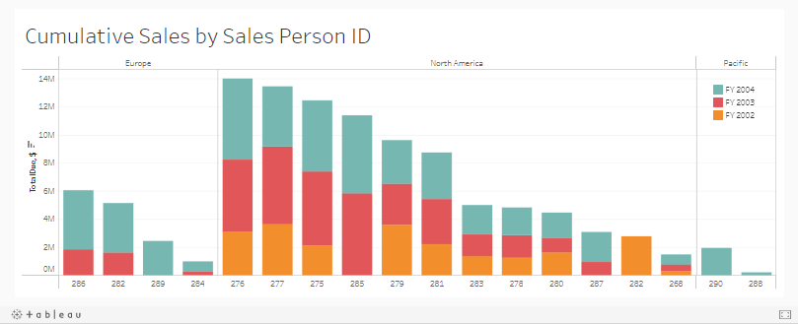
Sales Team Expansion
Notes:
Salespersons deal only with non online buying customers.
In 2002 4 new salespersons were involved into sales, in 2003 - 3 more. There was one drop off in 2002. Each Region has it’s sales manager.
4 top sellers make up 47% of all non online sales.

Slide 7
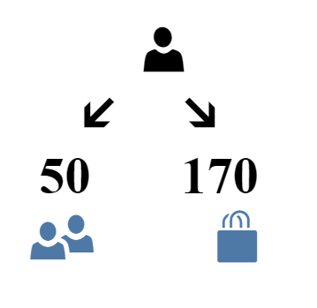
Notes:
One seller is capable to deal with 50 customers and manage 170 orders per year. Today we have 5 such sellers who work in this maximum load.
If we have the growth of 30 percent in sales we may still manage with the same amount of selling persons, but together we would have also a growth in customers for 30 percent, then the situation would change to maximum load of work for all selling persons and this would not be preferable. Due to this we need to thing about expanding the sales team with at least two additional persons.

Slide 8
Actions to take
Orders of bigger volume
Entering new markets with online sales as a strategy
Sales team expansion

